Slide 1
Week two notes

Slide 2
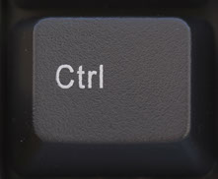
Ctrl key
Ctrl enables the key stroke
It is a fast alternative to using your mouse to make changes

Slide 3
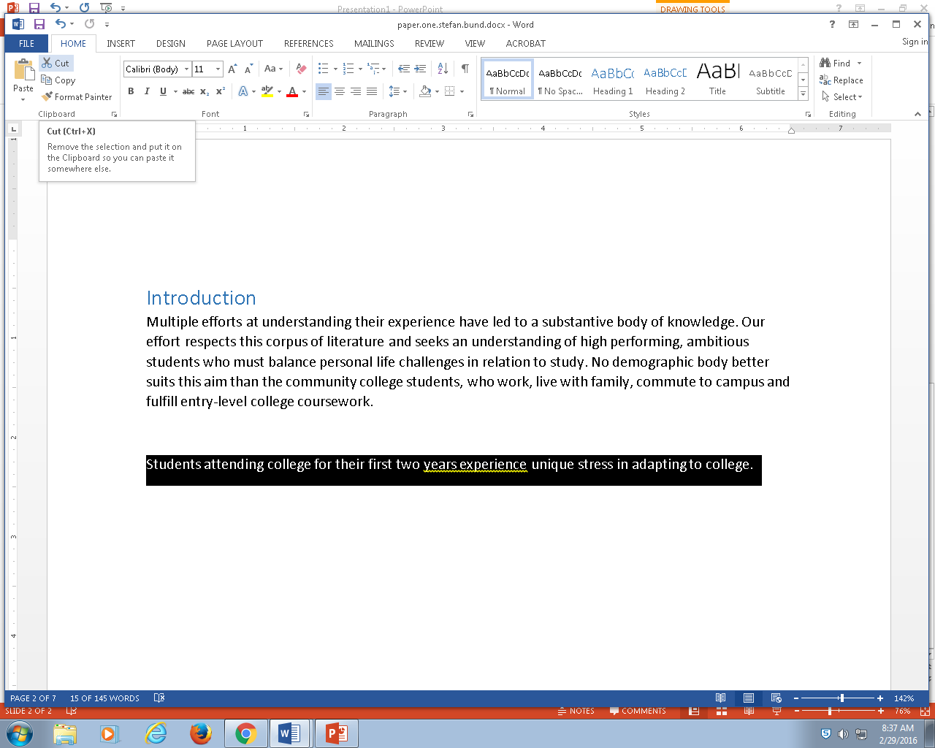
3 ways to do the same stuff
Use GUI in word, use your mouse to make changes

Slide 4
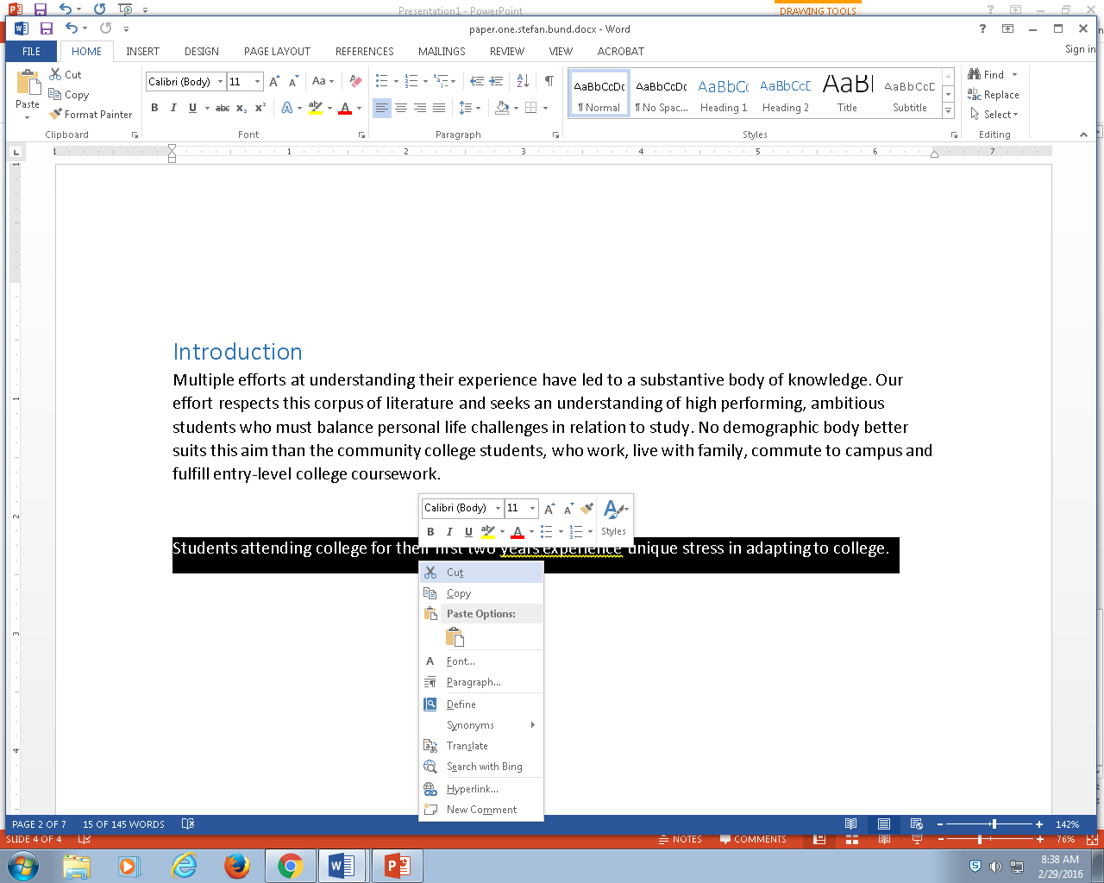
Use your mouse

Slide 5
Use key strokes (old school, fastest)
KEY STROKE
CTRL-C | COPY
CTRL-V | PASTE
CTRL-X | CUT + COPY
CTRL-Z | UNDO

Slide 6
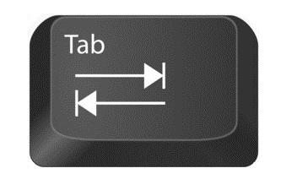
TAB BUTTON
Automatically provides margins for your text
Separate your writing using paragraphs, to provide division between ideas for your reader

Slide 7
Good writing
Divides a statement into concepts
One concepts leads to another
One idea builds upon the next
One true statement may lead to another
With enough truth, we may gain certainty, probabilistic direction

Slide 8
